Slide 1
Sexual health West Sussex
STIs and how to test
Health promotion & Digital services
Notes:
This brief presentation gives information on Chlamydia, Gonorrhoea, Syphilis & HIV – Sexually transmitted Infections routinely tested by sexual health services.
It also provides important advice on how and where to access testing for these conditions in West Sussex

Slide 2
Importance of early STI detection
STIs can have serious consequences and may be linked with serious health issues such as infertility and cancer
The majority of STIs occur without symptoms
Early HIV detection slows progression of disease, improves health outcomes and prevents further transmission
Notes:
STIs in the majority of cases are straightforward to treat.
However if left undiagnosed, they may risk serious long term health problems
HIV diagnosed early on, enables people to access care and treatment, meaning they can expect equally healthy and long lives as people who are not infected with HIV

Slide 3
What are the risk factors?
Source: Public Health England
Notes:
Young people aged 15-24 experience the highest rates of STIs in England
People from Black and Minority Ethic Communities are disproportionately diagnosed with infection, especially those who self-identify as Black Caribbean, Black African and Mixed race
Men who have sex with other men are more likely to be diagnosed with STIs and HIV
Deprivation is a key factor, with people living in poorer areas being more likely to be diagnosed with infections, that those living in less deprived communities

Slide 4
STI distribution by age & gender
Notes:
This chart shows STI diagnoses made in England in 2019 by age and gender
The chart shows females under the age of 25 in particular, being diagnosed with significantly higher rates of infection, compared with older women.
Whilst men aged 20-24 account for the highest rate of STis diagnose amongst men, the rate is significantly less than among women
However rates of STIs among men in all age groups over the age of 25 are higher than amongst women,
This may be in part due to diagnoses made among MSM

Slide 5
Chlamydia
How is it passed on?
Vaginal, oral & anal sex
Other sex acts : ‘fingering’/mutual masturbation/’dipping’
Why are we worried?
Can cause infertility in women
What are the signs & symptoms?
50% males show no symptoms
70% females show no symptoms
Pain passing urine/ vaginal & rectal symptoms
Irregular bleeding
Lower abdominal pain
Testicular pain
Notes:
Chlamydia is the most commonly diagnosed sexually acquired bacterial STI in England
Whilst condom use will significantly reduce risks of infection, Foreplay when secretions may be passed from person to person through touch, can spread infection.
Therefore all sexually active people should be encouraged to test, regardless of condom use
Chlamydia is of particular concern as it has been shown to lead to fertility problems among women. Particularly among those who have been exposed or infected on more than one occasion.
Chlamydia is spread easily, in no small part due to the fact that many men and women experience no, or minimal symptoms.
Chlamydia will not clear or resolve without treatment, meaning people can carry the infection unknowingly, long term.
If people do experience symptoms, these commonly include:
Genital symptoms, such as pain passing urine, irregular bleeding among women, particularly bleeding after sex or bleeding between periods.
Rectal infections may lead to pain, discharge and bleeding from the bottom
Both men and women may experience lower tummy or abdominal pain
Men may experience pain and tenderness in their testicles

Slide 6
Chlamydia
How quickly can people test?
Two weeks after sexual contact
Testing & diagnosis?
Self taken tests: urine, vaginal, rectal and throat swabs
Nurse/Dr taken tests (if symptoms)
How is it treated?
7 day course of antibiotic tablets (twice daily)
What advice should you give about testing?
Men who are having sex with men test every 3 months.
For everyone else testing should be done annually or following a partner change (preferably before sex with new or untested partners)
Notes:
Tests can reliably detect chlamydia infection two weeks after exposure.
Testing can either be self-taken at home or when attending a clinic or may be taken by a clinician (usually if someone has symptoms or requires support to test).
If diagnosed, treatment for chlamydia is usually a seven day course of antibiotic tables taken twice per day. These are accessed for free from sexual health services. Some people may choose to attend their GP for treatment.
We recommend all sexually active people to test regularly
Men who have sex with men should test every three months
For all others, testing should be taken annually or before sexual activity with a new partner

Slide 7
Gonorrhoea
How is it passed on?
Vaginal, oral & anal sex
Other sex acts : ‘fingering’/mutual masturbation
What are the signs and symptoms?
Green/Yellow discharge from vagina or penis
Pain passing urine
Testicular pain
Unusual bleeding
Lower abdominal (tummy) pain
Sore bottom and throat
10% males show no symptoms
50% females show no symptoms
Notes:
Gonorrhoea is another commonly occurring bacterial STI
It is most commonly diagnosed among MSM and young people and is passed on in much the same way as Chlamydia
Unlike Chlamydia, gonorrhoea is rarely associated with longer term health problems. It is however, often a painful infection, which leads people to seek care more rapidly
People with gonorrhoea are much more likely to experience symptoms. These include:
Green or yellow discharge from genitals – Often people may notice staining on their underwear as a result of this
Pain passing urine
Testicular pain
Lower abdominal or tummy pain
Unusual bleeding – between periods and after sex
People with rectal infection may experience pain discharge and bleeding rectally.
People with gonorrhoea in their throat may experience a painful, scratchy throat.

Slide 8
Gonorrhoea
How quickly can people test?
Symptoms can appear 2-5 days after exposure (sometimes sooner)
If no symptoms test two weeks after contact
How do people test?
Self taken urine, vaginal, rectal and throat swabs
Nurse/Dr taken swabs (if symptoms )
How is it treated?
One antibiotic injection
What advice should you give ?
Men who are having sex with men test every 3 months.
For everyone else testing should be done annually or following a partner change (preferably before sex with new or untested partners)
Notes:
Appearance of symptoms usually follows rapidly after exposure to gonorrhoea. Usually within 2-5 days. Some people however, may report symptoms within as little as 24 hours after infection. People with symptoms should be advised to seek care from a sexual health services as soon as possible
If people have no symptoms, but are worried they may have been exposed, people should seek testing after two weeks.
As with chlamydia, testing may either be self taken, or by a clinician, where symptoms are suspected
Treatment is by Antibiotic injection, which is available from sexual health services.

Slide 9
Syphilis
Why are we worried?
Syphilis, if untreated can lead to long terms health complications
It can cause particular harm during pregnancy and lead to miscarriage, stillbirth or infant death
It may increase the chances of HIV transmission
How is it passed on?
Anal, oral and vaginal sex
Rarely by skin to skin contact
What are the signs and symptoms?
Not everyone develops symptoms of infection
A sore or ulcer which appears around the genitals, bottom or mouth
Blotchy skin rash over body (also palms of hands and soles of feet)
Swollen glands in armpits and groin
Symptoms disappear and can lead to long term damage to body
Notes:
Syphilis is a bacterial STI which is less common that Gonorrhoea or Chlamydia. However, there has been a significant increase in cases in England in the past 25 years
if left undiagnosed can lead to a number of long term health problems which may affect the heart, lungs, brain and sight.
It is particularly dangerous during pregnancy and can lead to miscarriage, stillbirth or infant death
Syphilis infection may also increase the chances of HIV be passed on from person to person
Syphilis is mainly passed on by penetrative sex, and occasionally by skin to skin contact
Not everyone experiences symptoms of syphilis. Common signs may include
A sore or ulcer which appears on or around the genitals, bottom or mouth
A blotchy skin rash over the body which also appears on the palms of the hands and the soles of the feet
Swollen glands in the armpits and groin
Syphilis may cause damage to the body over a number of years if untreated
People can be infected by syphilis more than once.

Slide 10
Syphilis
How quickly can people test?
Symptoms can appear 4-6 weeks following exposure
It may take up to three months for tests to be conclusive
How do people test?
Via a blood test (self-taken finger prick or clinic-taken sample)
How is it treated?
Antibiotic injections
What advice should you give ?
Men who are having sex with men test every 3 months.
For everyone else testing should be done annually or following a partner change.
Notes:
Symptoms of syphilis make take up to 4-6 weeks to show up after exposure
However, it may take up to three months for tests to be conclusive
Testing for syphilis is by a blood test. These may be either self –sampled by the patient or taken by a clinician
People who have previously been diagnosed with syphilis should always seek testing from a sexual health clinic
Treatment for syphilis is usually by antibiotic injections given at a sexual health clinic
People should test routinely for syphilis, regardless of whether they have been previously diagnosed.
MSM should test every three months
All others should test annually or ahead of sex with a new partner

Slide 11
HIV
Why are we worried?
HIV Remains a life threatening condition if left undiagnosed
How is it passed on?
Infection passed on by condomless sex, injecting drug use & contaminated blood.
What are the signs and symptoms?
Flu-like seroconversion illness shortly after infection (for some individuals)
Reduces an individual’s immunity/ability to respond to infections
If left undiagnosed: weight loss, skin conditions, ear-nose & throat conditions, respiratory illnesses, opportunistic infections, cancers
Notes:
Rates of HIV have fallen dramatically in England over the past five year
HIV remains a serious, potentially deadly condition if people remain undiagnosed
HIV is passed on through condomless, penetrative sex, injecting drug use and contaminated blood & blood products
All sexually active people are at risk of HIV, but men who have sex with men and people from BAME communities are at higher risk
People who have been recently exposed and infected with HIV may experience a flu-like seroconversion illness within the first 1-2 months of exposure.
It is important to note that not all individuals will experience this seroconversion illness – and this highlights the importance of universal testing.
After seroconversion, people may not experience significant symptoms for a number of years
Undiagnosed HIV in many cases leads to a decline in an individuals health as the virus attacks an individual’s immunity. Signs include weightloss, frequent opportunistic infections which become more serious as time progresses.

Slide 12
HIV
How quicky can people test?
Testing can reliably detect HIV infection after 45 days (Window period)
How do people test?
Serology (laboratory) testing
May be patient collected or clinician taken
Point of Care Testing
Self testing & community/clinic testing
How is HIV treated?
HIV medicines (ART) suppress HIV in the body, allowing people’s immunity to remain intact
Early testing and ongoing treatment allow people living with HIV to enjoy long, healthy lives, comparable to people living without infection
Notes:
The window period for HIV infection is 45 days, meaning that tests can reliably identify infection between six and seven weeks after exposure.
There are two main ways to test for HIV
Laboratory testing, which involves sending blood samples to laboratories to be processed. These are highly sensitive accurate tests. Samples may be taken by either patients themselves or by clinicians
Point of Care or POC Testing. These are sometimes referred to as near-patient tests. These provide a result in as little as 60 seconds after testing. These tests are accurate and can work well where a quicker result in desired or needed. Where these tests find HIV, people would be routinely offered a laboratory test to confirm infections
ART or AntIretrovital threrapy, are ongoing treatments taken by people living with HIV. They suppress HIV in the body, allowing people’s immunity to function and preventing opportunistic infections from occurring.
HIV treatment is effective and, if commenced early after infection, allows people living with HIV to expect comparable health and lifespan as people living without infection

Slide 13
HIV
What advice should you give?
Early testing allows those diagnosed with HIV to access timely treatment
Someone diagnosed with HIV on effective treatment can go on to live a healthy life. Including pregnancy and breastfeeding without transmission
Effective HIV treatment means infection cannot be passed on (U=U)
Preventative treatments (PrEP & PEP) are available for free at sexual health clinics to those at risk.
Men who are having sex with men test every 3 months.
For everyone else testing should be done annually or before sex with a new partner
Notes:
Early diagnosis of HIV is vital to ensure that people access care and treatment in a timely manner.
Being diagnosed and accessing HIV care and treatment early on maximises the chances of living and staying healthy
Effective HIV treatment suppresses HIV in the body, making HIV undetectable.
Someone with undetectable HIV or an undetectable viral load, cannot pass on HIV through sexual contact,
This is referred to as U=U or undetectable equals untransmissible
Regular HIV testing is key
Men who have sex with men should test for HIV every three months
All other people should test annually or before sex with a new partner

Slide 14
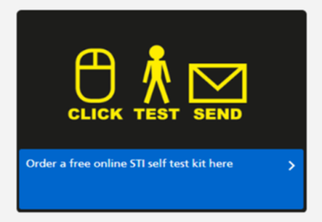
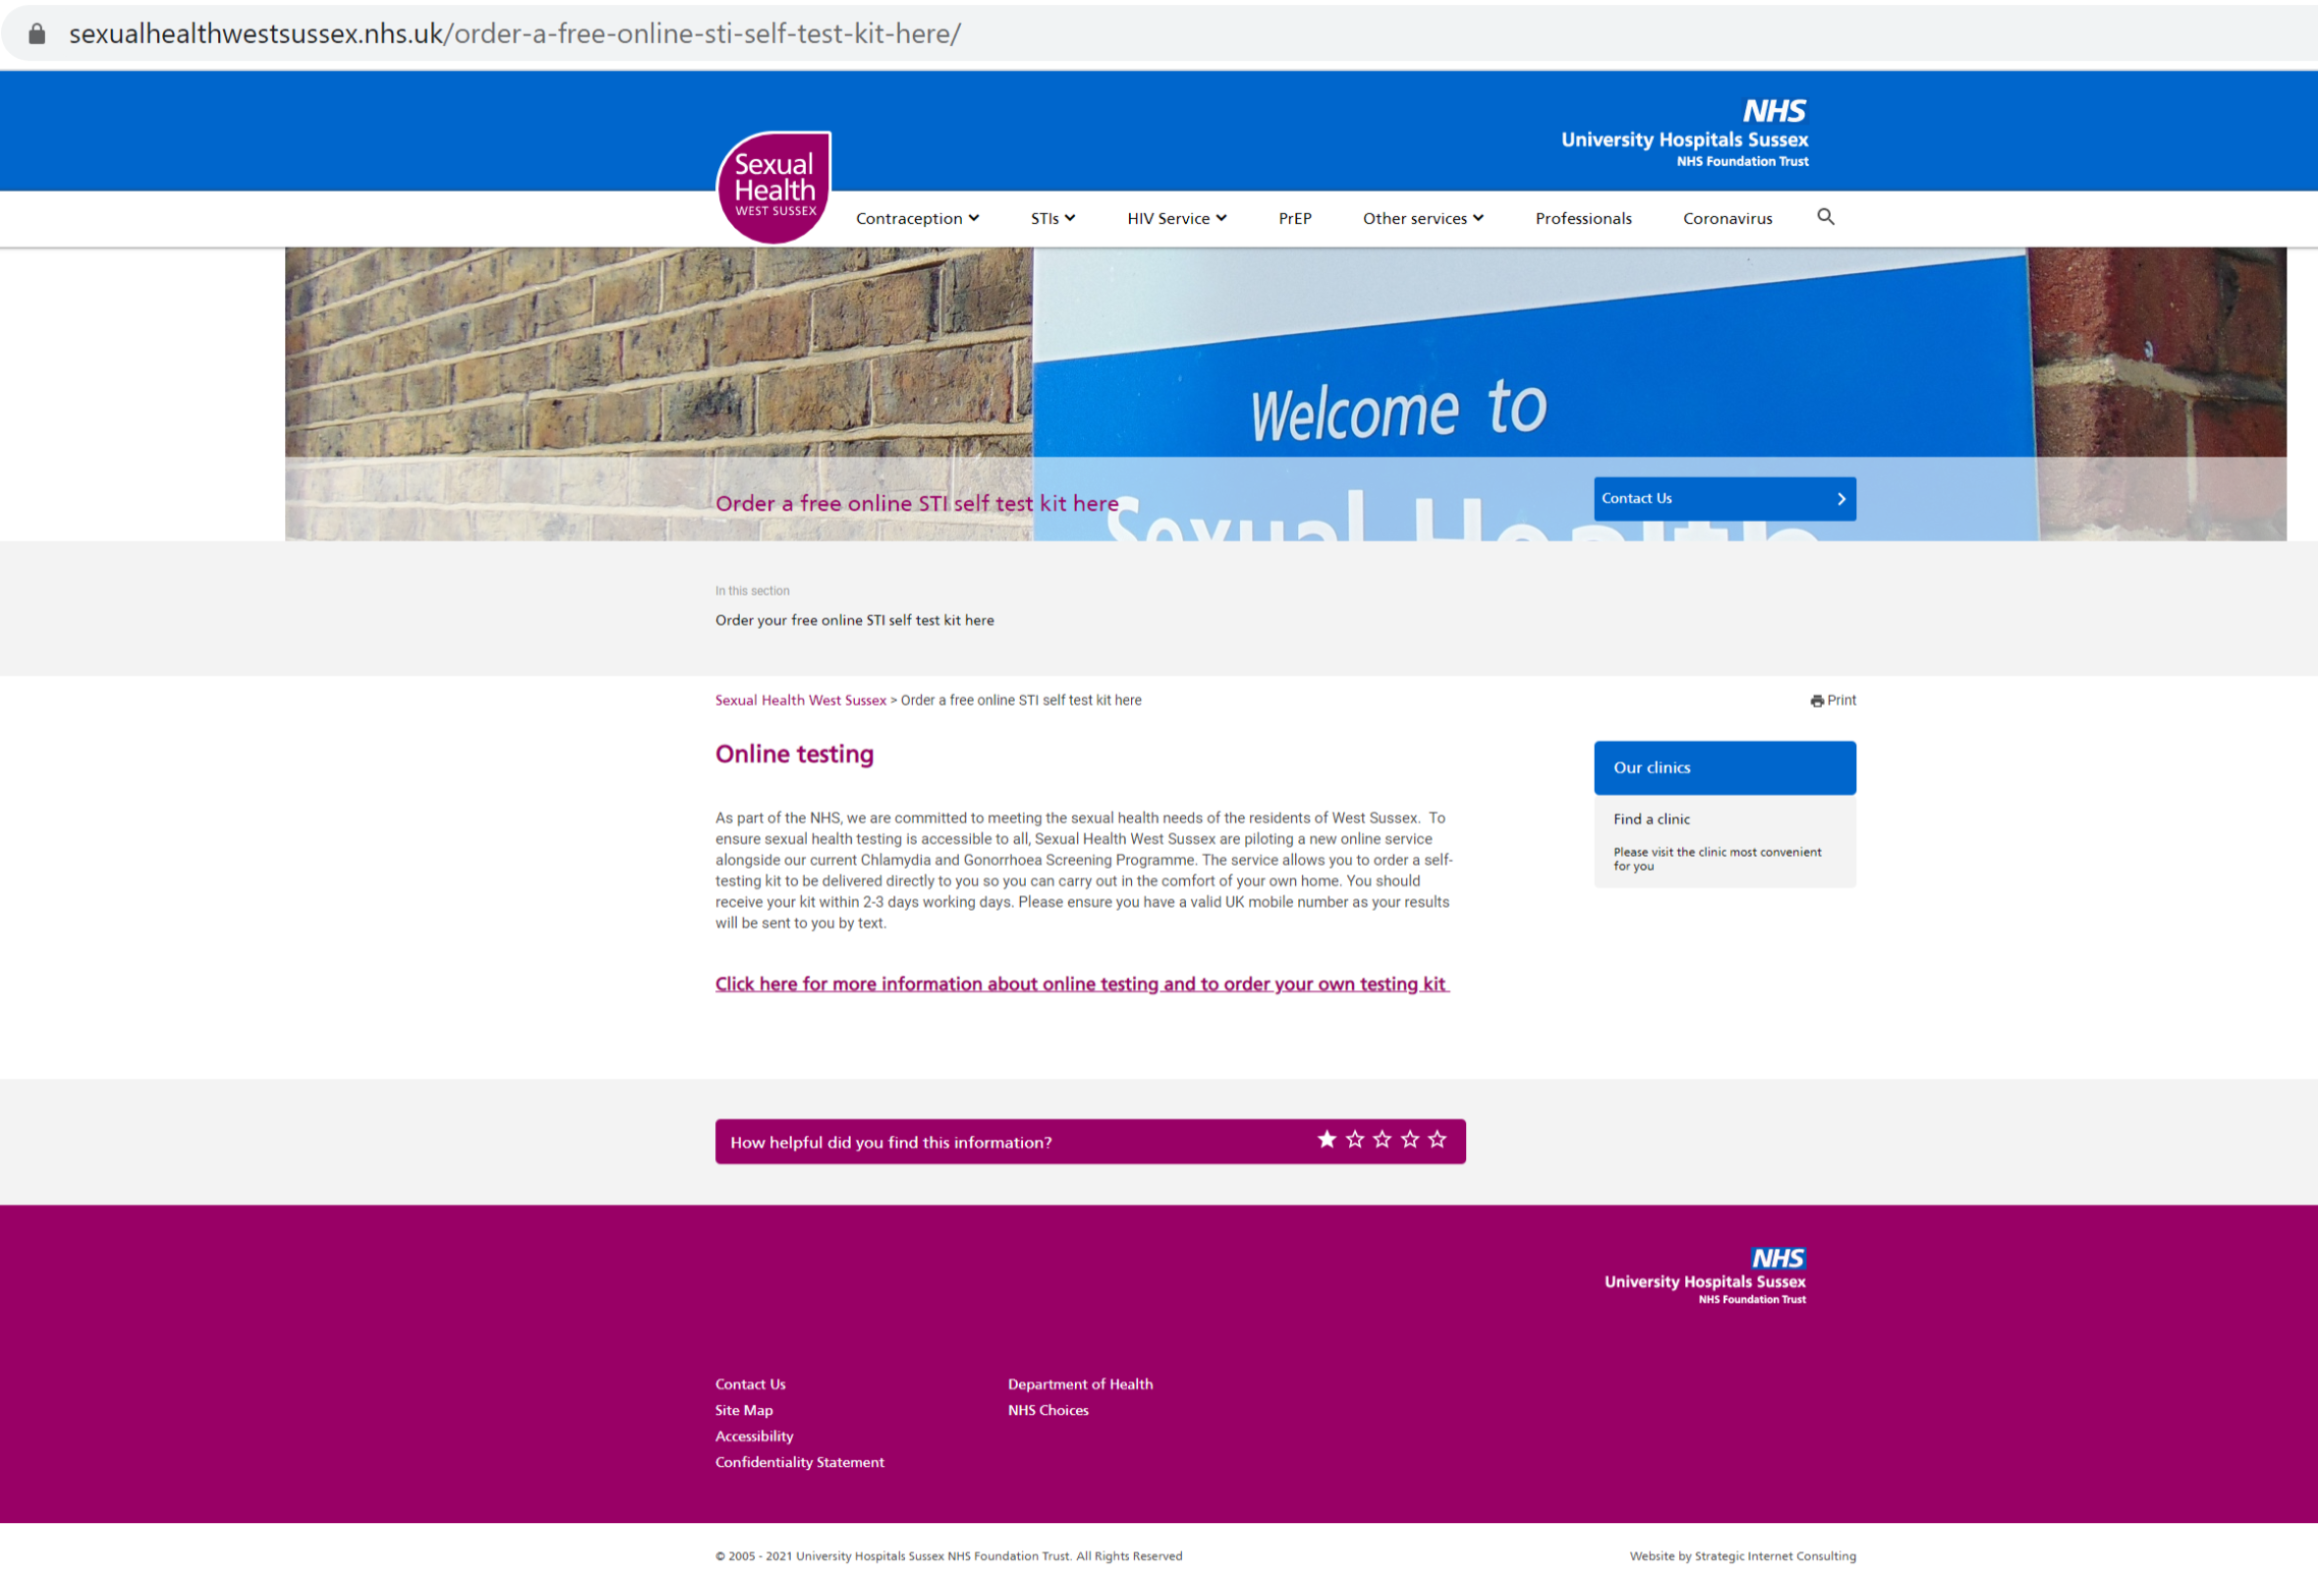
Sexual Health website
www.sexualhealthwestsussex.nhs.uk/order-a-free-online-sti-self-test-kit-here/
Notes:
The website contains links to our county wide Online testing service – Simply look for the Click Test Send icon and click on the link to the landing page for requesting a test kit.
To request an online test people complete a simple questionnaire and provide personal details including name, date of birth, mobile number and postal address

Slide 15
Online testing
What is online testing?
STI & HIV kits available to order: www.sexualheallthwestsussex.nhs.uk
Available for everyone aged 13 and above
Convenient, confidential and accurate
Can be posted to West Sussex address or collected from clinics
Self-taken tests (urine, swabs and finger-prick blood)
Notes:
Online testing refers to STI and HIV self-taken test packs, which people can do without having to attend a clinic.
Eligible for West Sussex residents aged 13 and above
The packs use the same tests as used in clinics, and are processed by laboratories, making them accurate and reliable.
The packs can either be posted to a West Sussex address or collected from a sexual health clinic. Packs are discreetly packaged in unmarked envelopes and sent via Royal Mail

Slide 16
What is in a self-test kit?
Swab/Urine test for chlamydia & gonorrhoea
Pre-paid envelope
Patient information leaflet
Bag for completed swab/urine sample
Blood testing pack.
Contains: blood tube & wrapper, lancets, plasters, and skin wipes
Laboratory
request form
www.sexualhealthwestsussex.nhs.uk/online-testing-tutorial-videos/
Notes:
Packs include self taken urine, swabs and finger prick blood tests, and offer comparable tests as attending a clinic, making them idea for people without symptoms who want to check themselves.
People simply follow the simple instructions included in the patient information leaflet, or watch the online video showing how to test
After tests have been completed, these can simply be posted in the pre-paid envelope

Slide 17
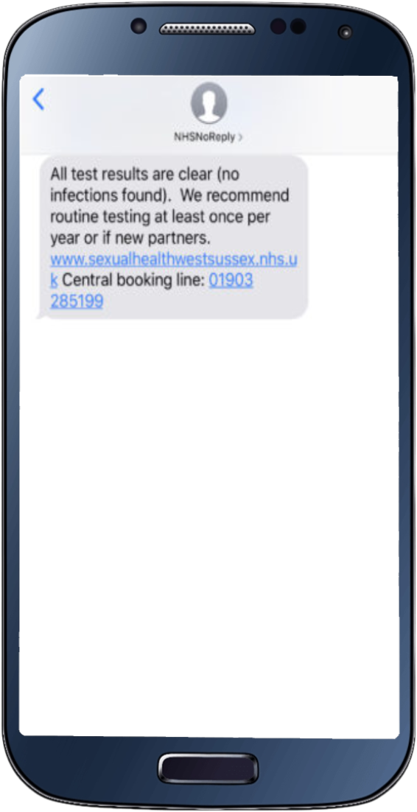
Online testing
Results within 10 working days direct to mobile
Available for everyone aged 13 and above
Online self assessment
Under 18s complete self-reported safeguarding assessment (followed by further telephone call if indicated)
Under 16’s Fraser and safeguarding assessments
by telephone call
Support for those with additional needs;
0800 0150 503
Notes:
Results are sent directly to the patient by SMS text message within ten working days of taking tests
Anyone aged 13 and above may request an online test.
People under the age of 18 will undergo further assessment and may speak with a clinician by telephone ahead of being sent a test
All under 16s will receive a telephone call from a clinician
We recognise not all people have internet access or will be able to access a digital platform. For those people, our freephone number provides additional, wraparound support, enabling people to access self sampled care or be supported into a clinical service

Slide 18
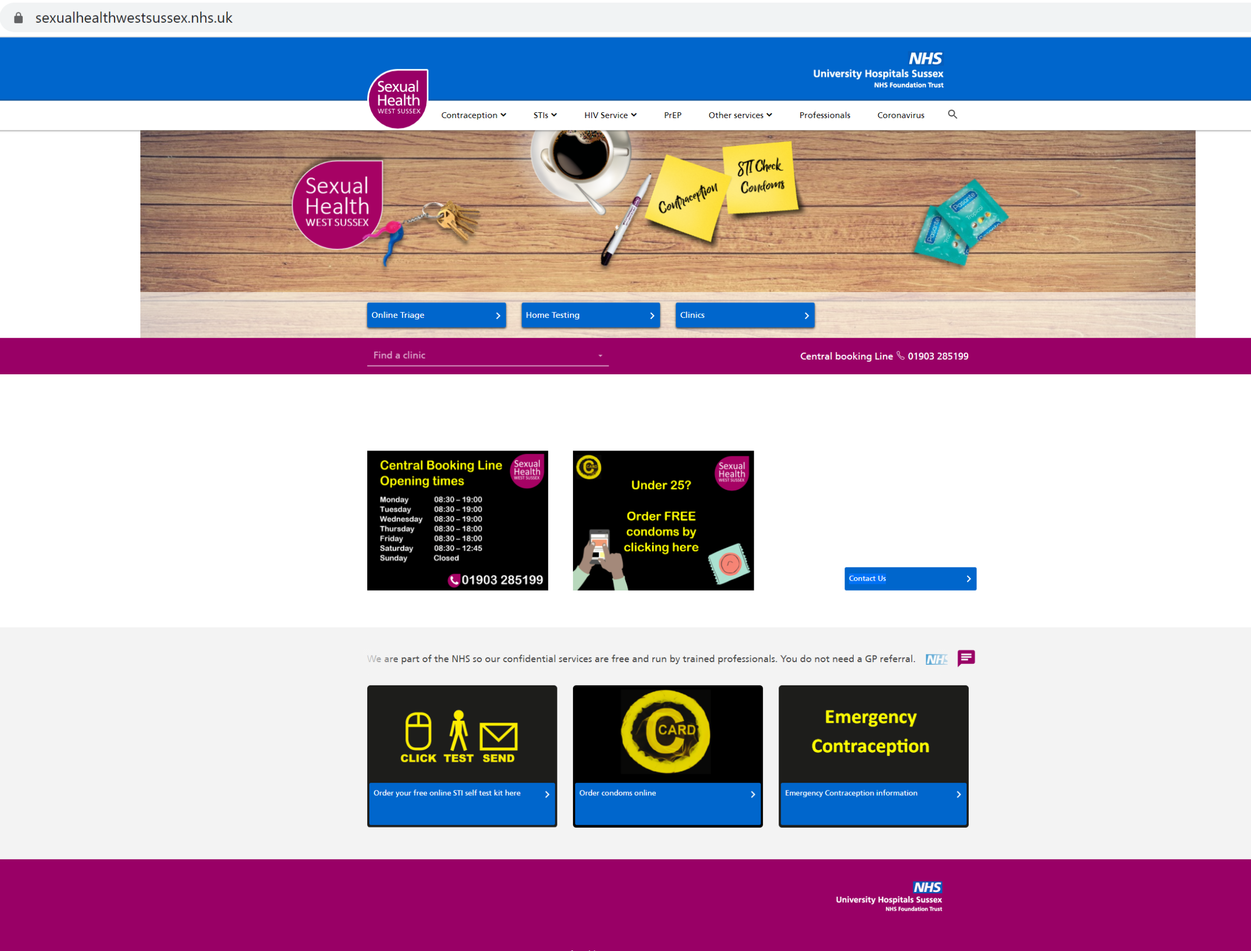
Sexual Health website
www.sexualhealthwestsussex.nhs.uk
Notes:
The Sexual health West Sussex website provides comprehensive information on all aspects of maintaining good sexual health and has comprehensive details of all our services across West Sussex
It’s the Front Door for people who want to access care and treatment in addition to providing a resource for other frontline services across the county
The website will provide regularly updated information on our clinical services and how we are delivering these as we move out of lockdown

Slide 19
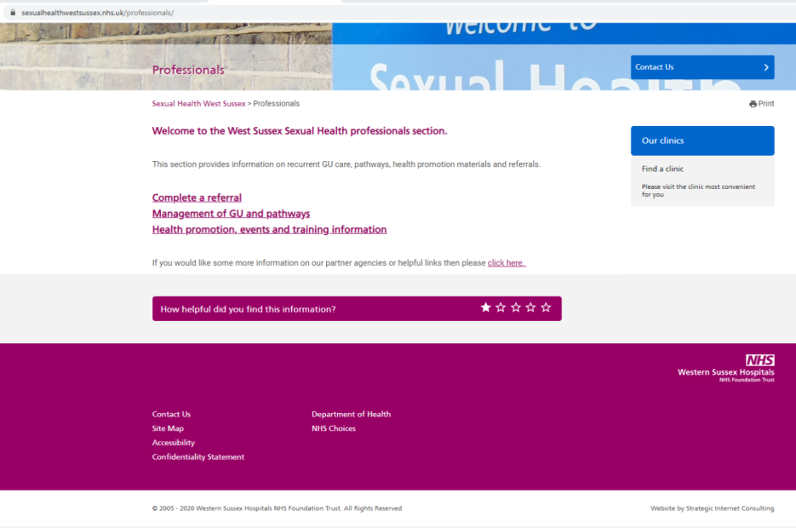
Access to services
01903 285199 - Central Booking Line (all sexual health clinics)
Patients may be offered telephone assessment prior to clinic attendance
Professionals page @ www.sexualhealthwestsussex.nhs.uk for direct referrals to outreach nurses
Notes:
The countywide central booking line provides access to all face to face care from our clinics across West Sussex and is accessible on 01903 285 199 during office hours between Monday and Friday
The Professionals page located on the West Sussex website provides referral information and online forms for professionals working across West Sussex, and may be especially useful if you are working with people you wish to directly refer for support or care.

Slide 20
Health Promotion team
0800 0150 503
Uhsussex.shonline@nhs.net
01293 541608 (Health promotion office)
Professionals training
Supporting access for vulnerable and high risk people
Targeted risk reduction
Notes:
Our countywide Health Promotion team are accessible by telephone or email to patients and professionals across the county and provide targeted support and training for vulnerable, high-risk individuals and communities who may not ordinarily access mainstream clinical services.

