Slide 1
Sexual health West Sussex
Sexual Health Risk Reduction
Notes:
In this brief presentation we look at some of the key approaches to reducing risks of sexual ill health.

Slide 2
The importance of risk reduction
Sexual ill health carries both short and long term consequences
STIs are often easily diagnosed and treatable, but may cause long term sexual health and reproductive difficulties
HIV remains a life limiting condition if left undiagnosed
Unintended pregnancy is a major consequence of inadequate or poor use of contraception
The above are potentially avoidable and cause significant cost to the NHS, the individual and local economy
Notes:
This slide addresses why addressing risk factors which may lead to poor sexual health can make a positive change for individuals, partners and the wider community
Poor sexual health not only carries short term or immediate harms; it can also lead to longer terms health and wellbeing consequences
A number of sexually transmitted infections may present with significant risks of longer term harm: including:
risks of fertility problems among women infected with Chlamydia,
complications associated with undiagnosed syphilis infection
and potential psychological impact and relationship difficulties experienced around living with conditions such as herpes simplex virus
There has been a significant reduction in the number of people living undiagnosed with HIV, but people still test late, meaning treatment may not work effectively and risks of dying early are increased
Unintended pregnancy carries significant risks and impacts. Whilst a proportion of these pregnancies will result in abortion, women electing to continue pregnancy will face increased risks of ill health as will the developing child.
Importantly all of these health challenges are potentially avoidable, and impact on individuals, communities and health and social care systems around them. Costs to the NHS alone of treating sexual health and reproductive health problems significant outweigh the costs of prevention or risk reduction.
We all have a critical, and personal responsibility in ensuring we develop the assets of those communities around us to educated and support individuals to make informed choices about their sexual health

Slide 3
STI/HIV Risk Reduction
Reducing sexual health knowledge gaps
Improving confidence in talking about sex and relationships
Regular STI testing (national guidelines)
(MSM test every 3 months, otherwise annually)
HIV Pre & Post Exposure Prophylaxis (PrEP/PEP)
Condoms
Emergency contraception & pregnancy options
Vaccination
Notes:
We’’ll be focusing on the following cornerstones of sexual health risk reduction:
Using information and education to reduce people’s knowledge gaps around maintaining good sexual health
Improving confidence in talking about sexual health and wellbeing.
Promoting routine STI and HIV testing
HIV Pre and Post Exposure prophylaxis
Condom use and contracpetion

Slide 4
What are the group at greatest risk of STIs?
Source: Public Health England
Notes:
As discussed in the STI presentation: young people, men who have sex with men, people from BAME communities and people living in deprivation has high risk of acquiring STIS

Slide 5
Importance of early STI detection
STIs can have serious consequences and may be linked with significant conditions such as infertility and cervical cancer
The majority of STIs occur without symptoms, meaning they pass from person to person more easily
Early identification of STIs means we can stop infections from spreading and reduce the risks of reinfection from occurring
Early HIV detection slows progression of disease and improves health outcomes
HIV treatment reduces the virus to an undetectable level, meaning HIV cannot be transmitted: U=U (Undetectable = Untransmissible)
Notes:
STIs are concerning because of the wider longer term health implications they carry
STIs are problematic because they may often appear without obvious symptoms in the first instance
More regular and routine testing for STIs means we are more likely to identify previously undiagnosed infection earlier, meaning infections have less opportunity to pass on,
Earlier diagnosis of HIV enables people to access effective care and treatment sooner,
This improves the longer term health and chances of the person living with HIV and also means they are less likely to pass on HIV infection to other people as the virus is effectively controlled by HIV ART

Slide 6
Testing as risk reduction Here is the advice you can give…
STI testing enables people to make informed choices about their sexual health and sex lives.
It enables us to treat previously undiagnosed infection, inform sexual partners, support and educate people to reduce risks of repeat infection
We encourage all sexually active adults to testing yearly, or more frequently if changing sexual partners
Men who have sex with other men should test every three months
People may attend clinic for testing or order online: www.sexualheallthwestsussex.nhs.uk
Testing won’t indicate if a sexual partner has infections or not. The only way to be certain about them is for them to test.
Notes:
We want you to be able to encourage people to test for STIs and HIV. Here are some key messages you can give:
Regular testing is a key risk reduction approach
It enables people to take control and make informed decisions about sex and relationships and plan their approach to risk taking
Early and regular testing allows for prompt treatment and contacts to be traced where people are diagnosed with infection
This helps prevent the onward spread of infection and also gives an opportunity to offer education and support to address risks and to reduce likelihood of repeat or further infection
Testing is quick, easy and pain free
All sexually active adults should test yearly, or more often if changing sexual partners
MSM should test every three months
People may test in clinic or request a test online. Please go to our website, www.sexualhealthwestsussex.nhs.uk for details of all our services
Testing will only reliably show whether the person testing has an infection or not. It wont show if a partner has an infection. The only way to be certain is for that partner to test themself

Slide 7
HIV PrEP & PEP
HIV Pre (PrEP) and Post (PEP) Exposure Prophylaxis
HIV PrEP & PEP are tablets which can prevent people from acquiring HIV infection
They are issued for free by NHS from Sexual Health Clinics to people assessed to be at higher risk of HIV infection
PEP available out of hours via hospital emergency departments (A&E)
PEP can be given if someone has condomless sex with and HIV +ve person not on medication or someone at higher-risk (usually MSM or someone from area with high infection rate) within 72 hours of contact and is taken over four weeks
PrEP is given to people who have ‘riskier activity’ (condomless sex) with higher risk sexual partners. Usually taken on a daily basis
People who take PEP/PrEP will still be at risk or other STIs, so will need regular testing (every 3 months)
Notes:
HIV Pre Exposure Prophylaxis and HIV Post expusre Prophylaxis or PrEP and PEP are key in helping prevent the spread of HIV infection
They are medicines given by sexual health services, which if taken before or after risky sex where HIV may be passed on, will dramatically reduce the risks of transmission
In addition to accessing Post exposure prophylaxis in sexual health clinics, it can be accessed our of hours or at weekends by hospital A&E departnments
HIV PEP can be given within 72 hours of expusre, but it works at its best if started within the first 24 hours. It will be taken for a period of four weeks
Pre Exposure prophylaxis or PrEP is given to people to take on a daily basis if they are having ongoing riskier sex with higher risk partnerns.
People who take PEP and PrEP will be monitored by sexual health services and will be encouraged to test every three months
The following slide shows a brief film highlighting the key differences between PrEP and PEP

Slide 8
HIV PrEP & PEP

Slide 9
HIV PrEP & PEP Here is the advice you can give….
Men having sex with men, trans men and women, people from areas with high rates of HIV should know about PEP and PrEP, how and where to access
HIV PrEP & PEP can prevent people from acquiring HIV infection
They are tablets which are:
Taken on a daily basis (PrEP)
Taken after HIV exposure for 28 days (PEP)
They are available for free from sexual health services. For more information go to: www.sexualhealthwestsussex.nhs.uk
PrEP won’t protect people from STIs. Condoms are still the most effective way to prevent against STIs
People taking PrEP will need to test regularly (every three months)
Notes:
Please think about the people you work with – If they include men who have sex with other men, trans men and trans women, and people from countries with high rates of HIV infection, these are the populations we want to be informed about PEP and PrEP. Too many people remain unaware of these options to prevent HIV infection
Tell people HIV PrEP and PEP are really effective at preventing HIV infection
PrEP is taken on an ongoing basis by people who are at ongoing higher risk of acquiring HIV
PEP is taken as an emergency within 72 hours of exposure for 28 days
PEP and PrEP are available from sexual health services. PEP can also be accessed out of hours by A&E hospital departments. Signpost people to www.sexualhealthwestsussex.nhs.uk for further information
PrEP only prevents against STIs. Condoms are still a really effective at preventing infections that may be passed by vaginal and anal sex
People taking PrEP will need to test for STIs and HIV every three months

Slide 10
West Sussex condom distribution scheme (CDS)
Refreshed scheme launched 1st February 2021
To improve condom access and improve links to contraception & STI care for 13-24 year olds living in West Sussex
Notes:
Condoms are the only means of contraception which also offer a barrier against sexually acquired infections and HIV
They are an important means of reducing risks of unintended pregnancy and STIs
West Sussex provide a condom distribution scheme offering free condoms and lubricants to all people living in West Sussex aged between 13-24

Slide 11
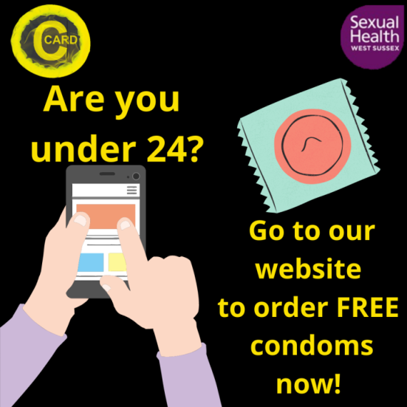
CDS
Online request and registration
Embedded online condom demonstration
Inbuilt <18 safeguarding assessment based on “Spotting the Signs” model
Additional telephone assessment for <16s and 16/17 year olds with safeguarding need
Postal delivery to West Sussex address
Click & Collect pathway for those accessing face to face youth or clinical settings.
Notes:
The recently relaunched scheme allows for online requesting of condoms and lubricant and features and embedded demonstration video as part of the registration process
The scheme offers inbuilt safeguarding and Fraser competency assessment, providing additional telephone support for vulnerable and younger people accessing the scheme
Young people have an option to request condoms to be delivered to a West Sussex postal address or to pick them up them from a designated collection point located across the county

Slide 12
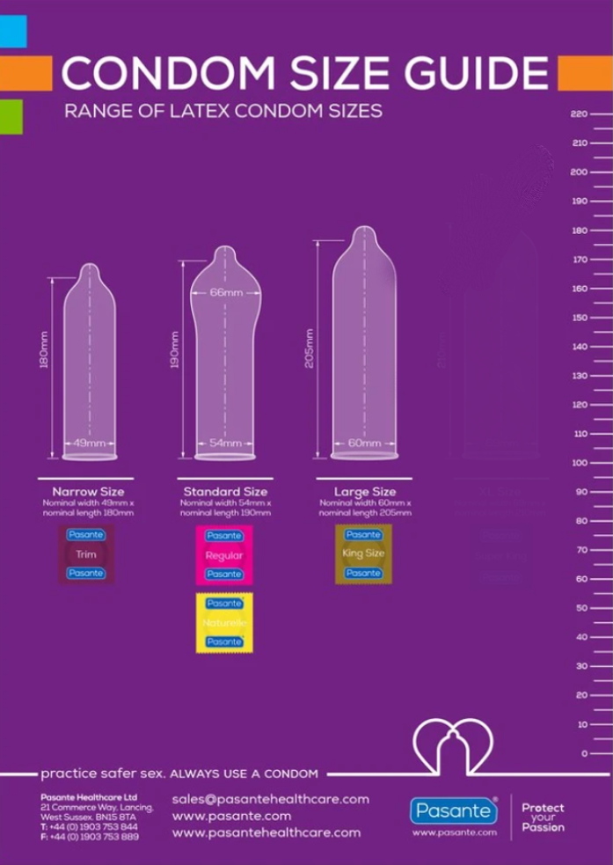
CDS
Choice of condom fit & size
28 condoms plus lubricant per order
Scheme allows up to x4 requests per annum
5 working day turnaround for all requests
Click and collect sites provide additional wraparound support
Partner agencies pivotal in providing ongoing sexual health promotion and signposting/access to website
YP with additional safeguarding needs will be routed to face to face services / West Sussex Integrated Front Door (IFD)
SMS text messaging offering prompts and access to online STI testing and face to face sexual health care
Notes:
The scheme offers a choice of condom fit and size
Providing 28 condoms plus lubricant up to four times per year
There is up to a five day turnaround for all requests.
Click and collect sites will provide opportunistic wraparound support for young people accessing face to face collection and will be an important point for additional health promotion and signposting
People with additional needs will may be offered support and access to face to face clinical services. For those with safeguarding needs, referral will be made to West Sussex Integrated Front Door.
SMS text messaging will be sent to young people offering prompts to encourage access to regular STI testing and encourage access to contraceptive choices to further reduce unintended pregnancy risk

Slide 13
CDS Here is the advice you can give….
Condoms are effective at preventing pregnancy and STIs
They are available for free for 13-24 year old West Sussex residents by calling 0800 0150 503 or www.sexualhealthwestsussex.nhs.uk
People aged 25 and over can access free condoms from sexual health clinics
Talk about condom use and contraception with all partners.
Use condoms with new partners until you have both been tested for STIs
Notes:
Here are some simple messages you can give to people about condoms and how to access them
Condoms are still the most effective way to prevent STIs and also work well to prevent pregnancy for people who aren’t using any other form of contraception
The West Sussex Condom Distribution Scheme offers free condoms and lubricants for all residents aged between 13 and 24. For more information, people can access the sexual health website or call freephone 0800 0150 503 for more information
For people aged 25 or over, they may access free condoms from our sexual health clinics. Again, people should be encouraged to go to the website for further information on how and where to access clinics
We want to encourage people to talk about condom use and contraception with all partners, but especially new partners.. While these conversations can take courage and might feel awkward, they are really important in reducing the likelihood of STIs or unplanned pregnancy from happening.

Slide 14
Condoms have their uses, but…

Slide 15
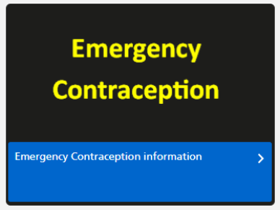
Emergency contraception Here is the advice you can give….
Emergency contraception reduces risks of unintended pregnancy
Options are:
Tablets or ‘morning after pill’
A ‘coil’ which is fitted inside the vagina
It works at its best within 24 hours, but can be given up to 5 days after sex; available via sexual health clinic, GP or pharmacy
Free emergency contraception for people aged 13-21 via 49 community pharmacies across West Sussex https://www.sexualhealthwestsussex.nhs.uk/contraception/emergency-contraception/
If people are pregnant and too late for emergency contraception please go to https://www.msichoices.org.uk or call 0345 300 8090
Notes:
Please view the emergency contraception webinar for further details on emergency contraception options.
We want you to be able to inform people what emergency contraception is, and when and where to access it
Tell people not to delay if they are worried thay may have been at risk. While people have up to five days, emergency contraception works at its best within the first 24 hours
Options for emergency contraception are tablets, sometimes known as the morning-after pill and a contraceptive coil, which is fitted by a clinician
Emergency contraception can be accessed from Sexual health clinics, GP or Community pharmacies in West Sussex
Details of a community pharmacy scheme offering free emergency contraception to West Sussex residents aged under 21 is available on the sexual health website
For people who are pregnant and too late to access emergency contraception, care, support and information is available from MSI choices,, a pregnancy options service in West Sussex. Please go to their website or call 0345 300 8090

Slide 16
Vaccination Here is the advice you can give….
Vaccination can offer immunity from harmful disease
Sexual health services offer vaccination against the following conditions which may be sexually acquired for people from high risk groups:
Hepatitis A
Hepatitis B
Human papillomavirus (HPV)
Hepatitis infection may lead to long term liver damage
HPV is linked to cancers
Vaccines as safe and effective and will be offered routinely to men who have sex with men and sex workers
Notes:
Vaccines are a vitally important way of offering protection or immunity against disease
Sexual health services offer the following vaccinations
Hepatitis A & B – to protect against Hepatitis, an infection who can lead to long term liver damage
Human papilomavirus or HPV – sometimes know as wart virus. Being vaccinated dramatically reduces chances of developing HPV, which is know to lead to certain types of cancers.
Vaccines can sometimes provoke uncertainty or concerns. Vaccines given by sexual health services are safe and effective.
Certain groups are at higher risk of infection from hepatitis A/B and HIV, these include men who have sex with men and sex workers. Sexual health services will routinely offer these vaccinations to eligible people, if they have not been previously vaccinated

Slide 17
Access to services
www.sexualhealthwestsussex.nhs.uk
01903 285199 - Central Booking Line (all sexual health clinics)
0800 0150 503 – Sexual Health Outreach team
Referrals www.sexualhealthwestsussex.nhs.uk/referrals
Notes:
The sexual health website provides comprehensive information on many aspects of sexual health for patients, public and professionals and gives information of all our services in West Sussex and how to access them
For people seeking face to face care, the Central Booking Line provides telephone books for clinics across West Sussex
For vulnerable, high risk patients, who may not engage in mainstream services, or who require additional support, please contact the sexual health outreach team on 0800 0150 0503
Referral forms for specialist contraceptive and sexual health services and referrals of vulnerable clients to the outreach team can be found on the professionals section of the website

